Slide 1


Slide 2
Starter for 10
Let’s get thinking… In front of you, you have 10 pictures:-
Try to sort them in to two piles. (As you are working consider the following questions…)
Have you completed this sort of activity before?
Why have you decided to sort the photographs like this?

Slide 3
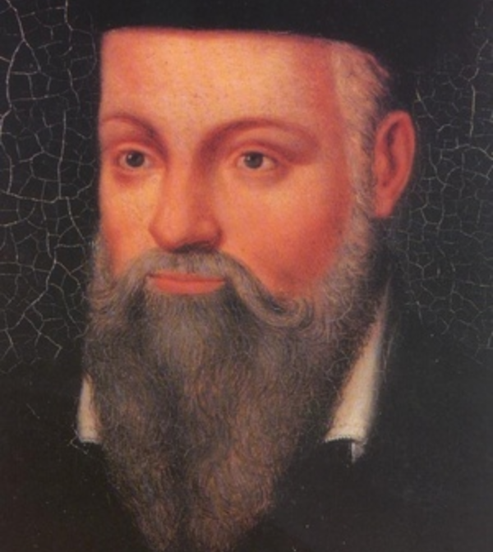
Prediction
Can you work out what we are going to be learning about today??
Note down your predictions…

Slide 4
Why do people migrate?
How good were your predictions?
The question that we’re asking today is…

Slide 5
Objectives
By the end of this lesson you will:-
Understand the variety of reasons why people ‘migrate’ from one place (or country) to another
Understand what is meant by ‘push’ and ‘pull’ factors

Slide 6
Time for a re-think…
Sort the photographs into two new piles.
Pile 1:- Reasons why people may leave a country or region
Pile 2:- Reasons why people may be attracted to a country or region
Assign one group member as the scribe to complete the table, you should have one reason for each photograph…
Reasons why people leave a country or region | Reasons why people area attracted to a country or region
Disasters such as volcanic eruptions may force people to leave as it is not safe to stay in the area.

Slide 7
From the previous task can you now define ‘Push’ and ‘Pull’ factors
Push factors:-
Pull factors:-

Slide 8
Classifying Migration
Sort the pictures using the following headings:-
Political migration
Economic migration
Environmental migration
Social migration
Why did you make these selections?
Be prepared to explain yourselves!
Have you seen these words before?
Are there any clues to what these words might mean?

Slide 9
Why do people migrate?
Paired activity:-
Pair 1:- Read Gassama’s story
1) Highlight the problems Gassama faced in trying to get to Europe.
2) Pick the three that you feel are the most important and make a note of these. You will need to explain your choice!
Pair 2:- Read the article How I was smuggled into Europe
1) Highlight the reasons why Moutassem decided to leave Syria. Pick what you feel is the most important reason.
2) In a second colour highlight the challenges that Moutassem faced in getting to Europe.
3) Of the problems that you have highlighted, which do you think is the most serious?

Slide 10

What causes migration?
Summarise the causes of migration as a 140 character Tweet…

Slide 11
Time to refelect…
What thinking strategies have you used in today’s lesson?
PREDICTION?
ORDERING?
RANKING?
SUMMARISING?

